Slide 1







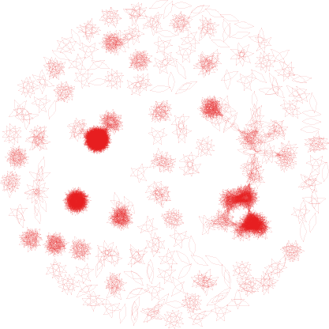
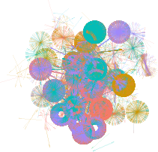
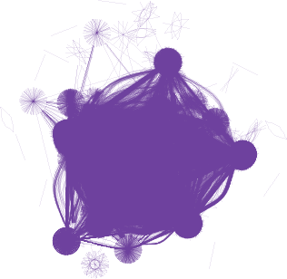
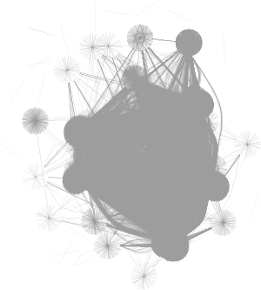
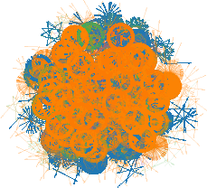
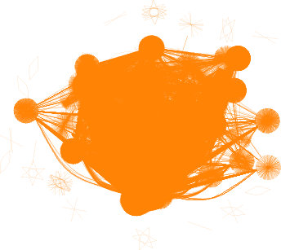

How do our maps look like?
I
R
A
?
A
B
C
B
Proteins only – human only
One canonical isoform – proteoform per gene

Slide 2
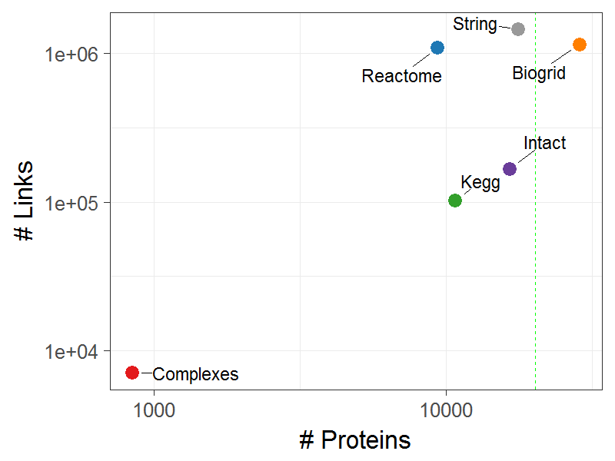
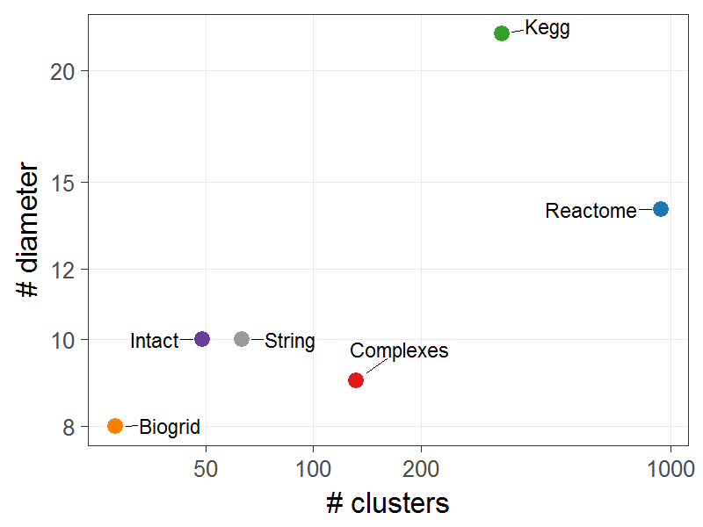
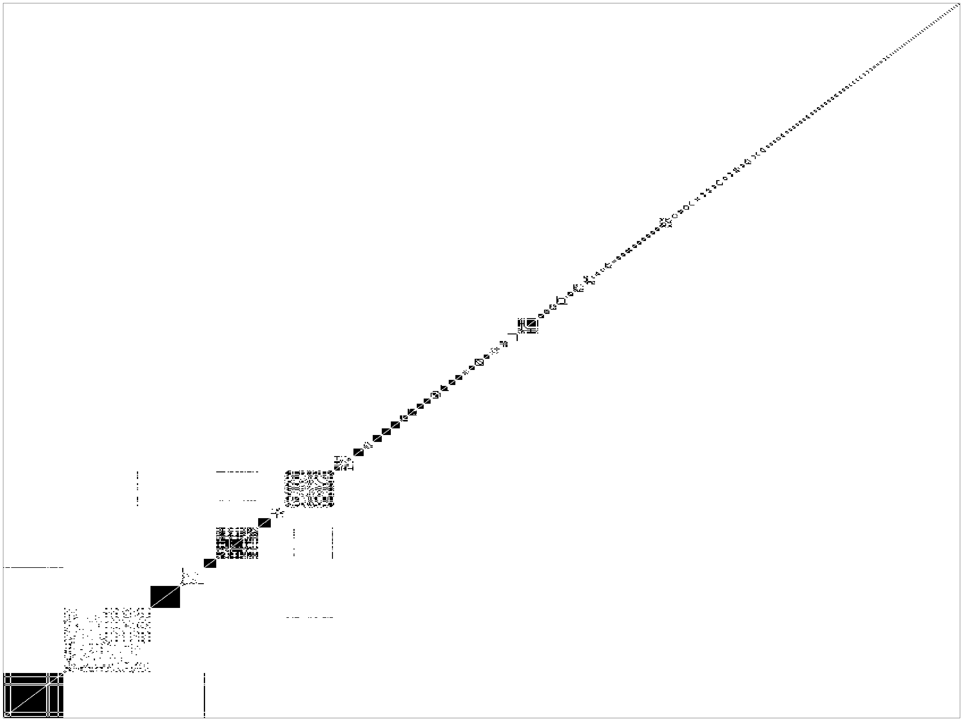
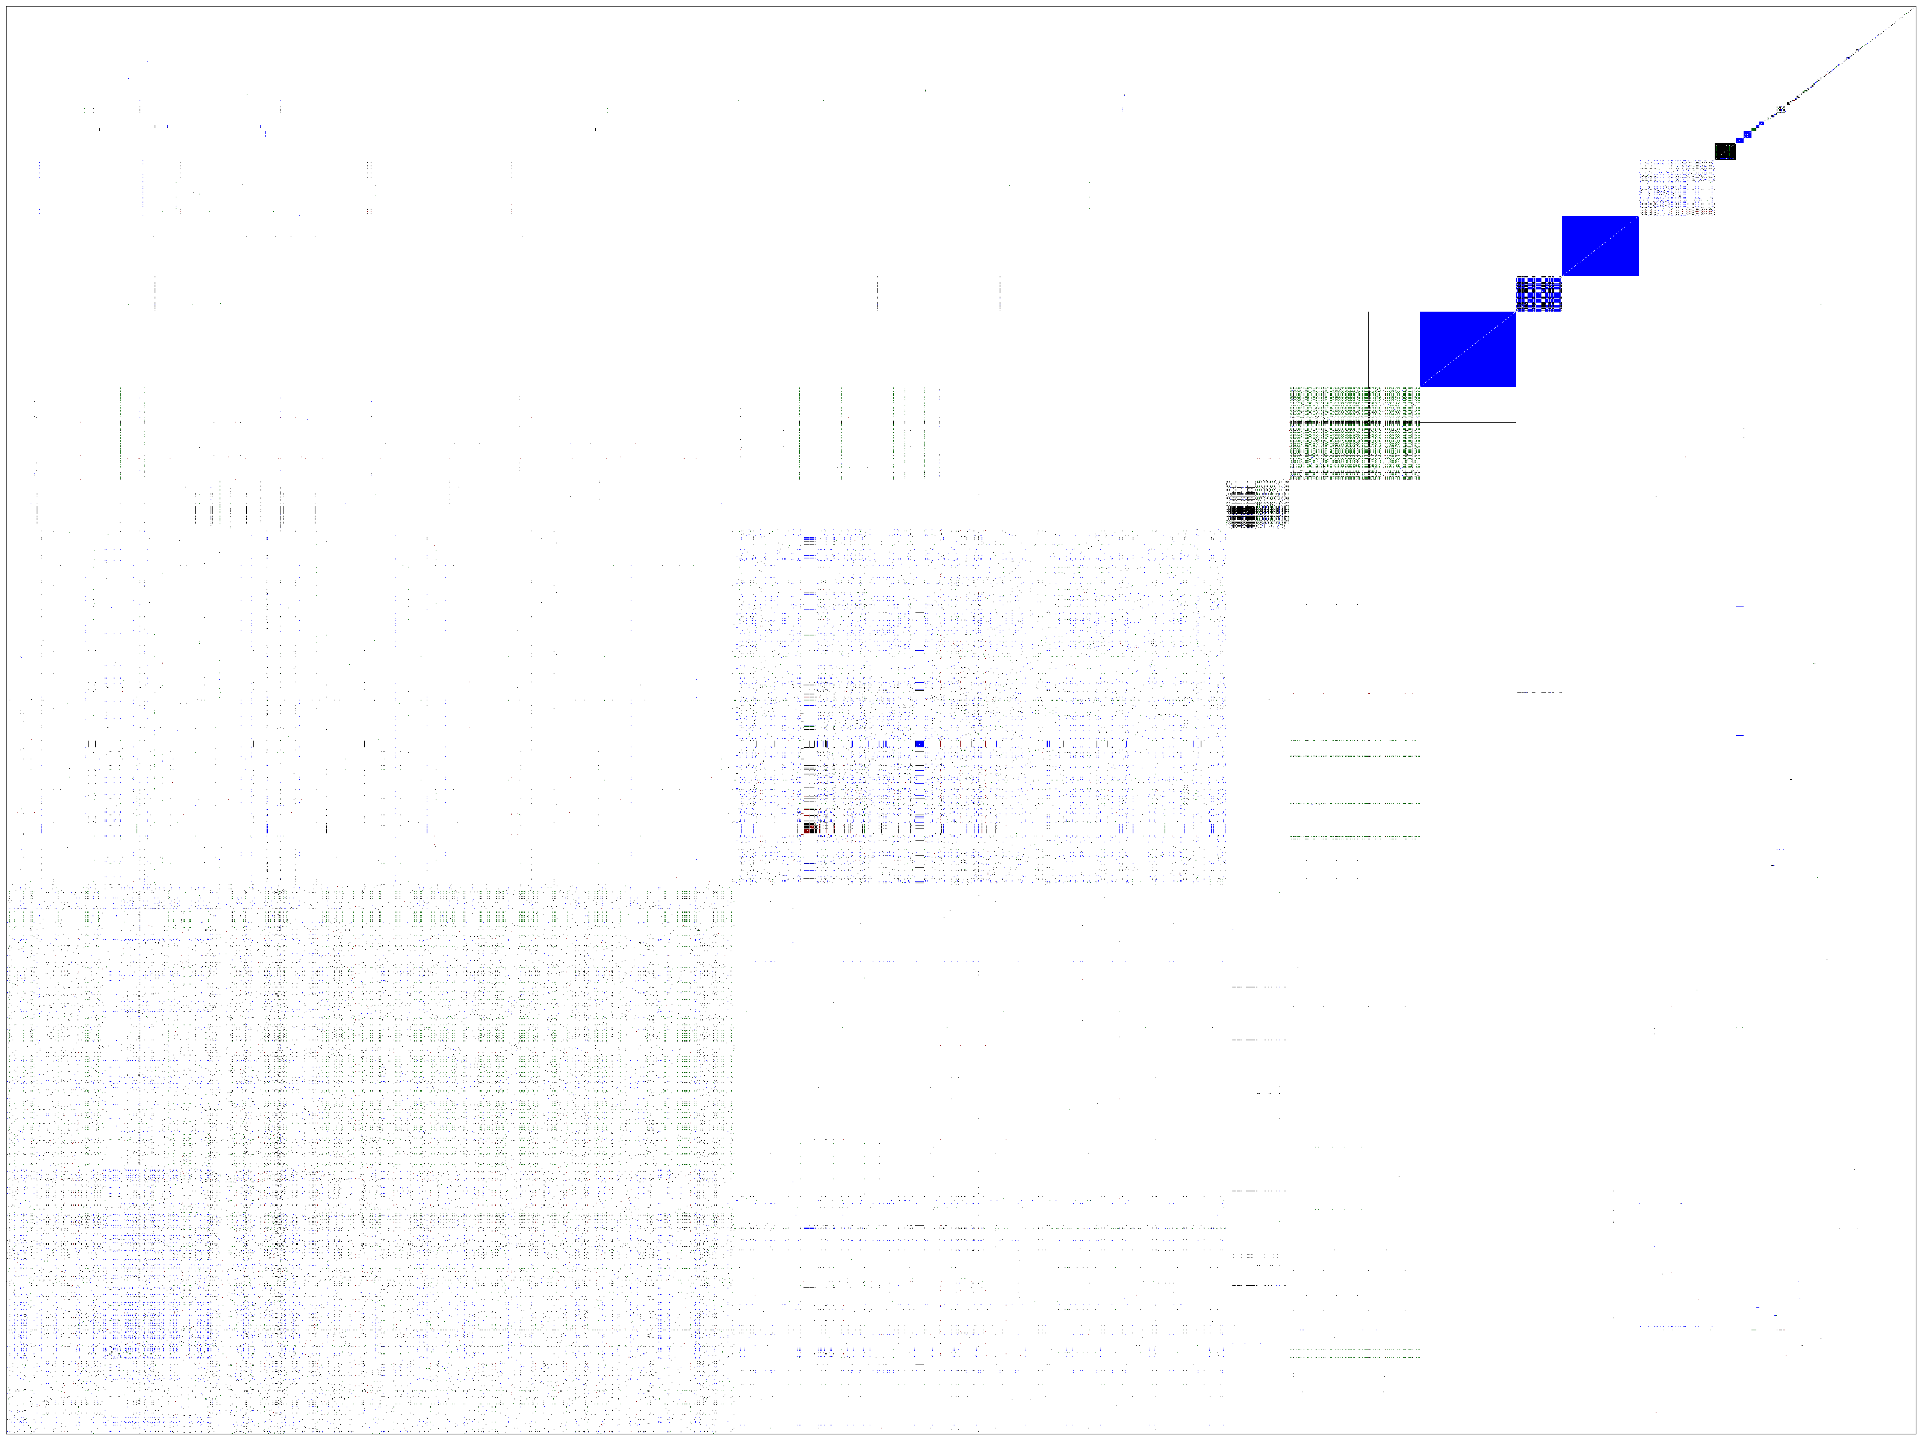
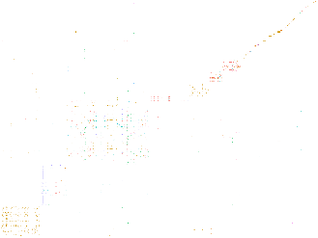
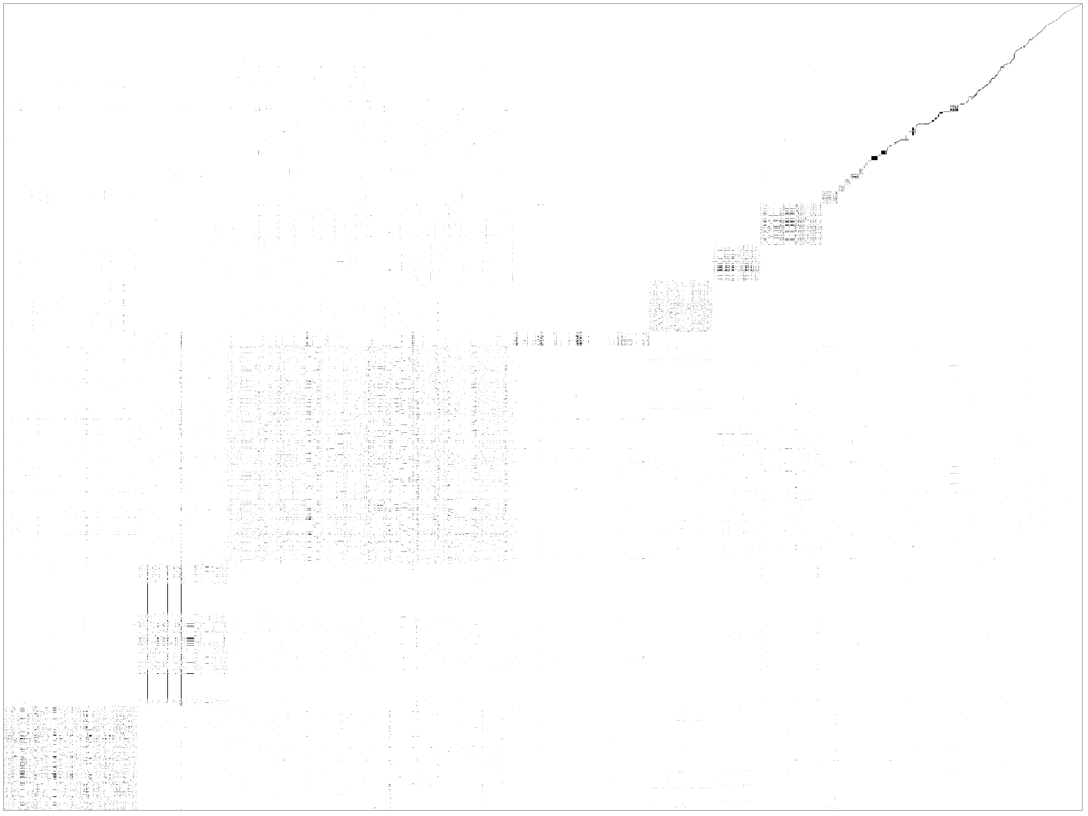



How do our maps look like?

Slide 3
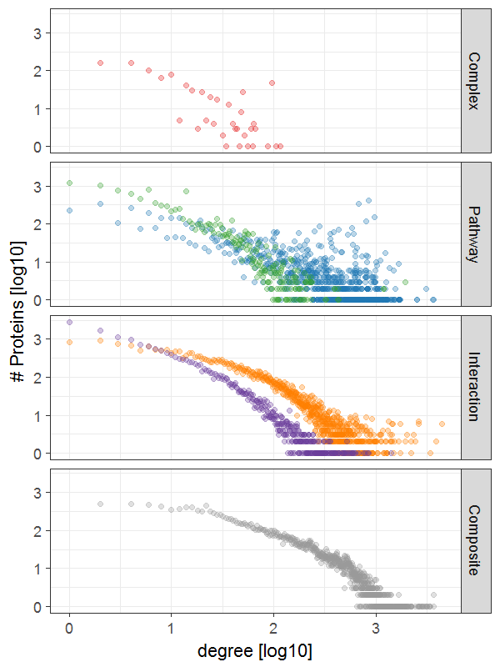
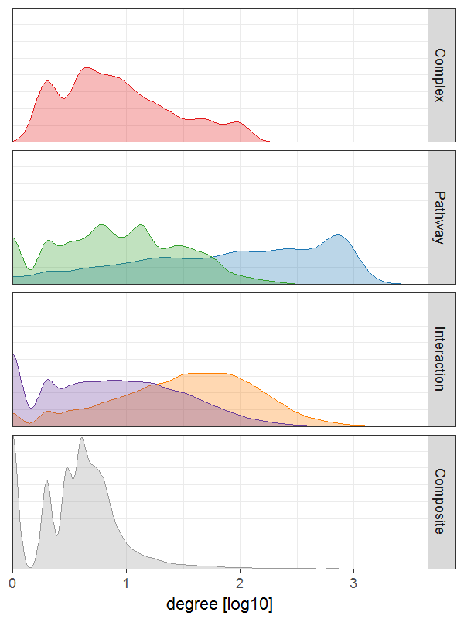
How do our maps look like?

Slide 4
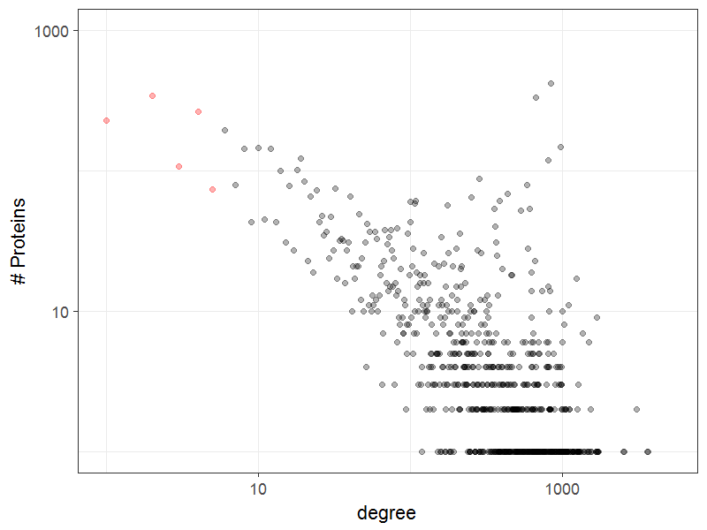
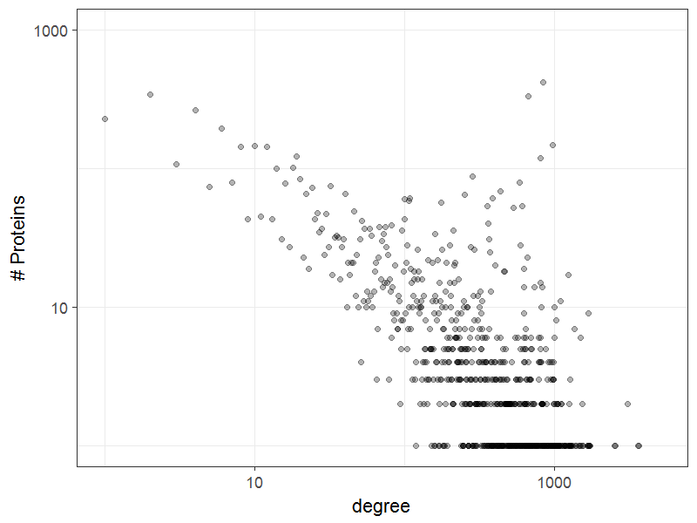
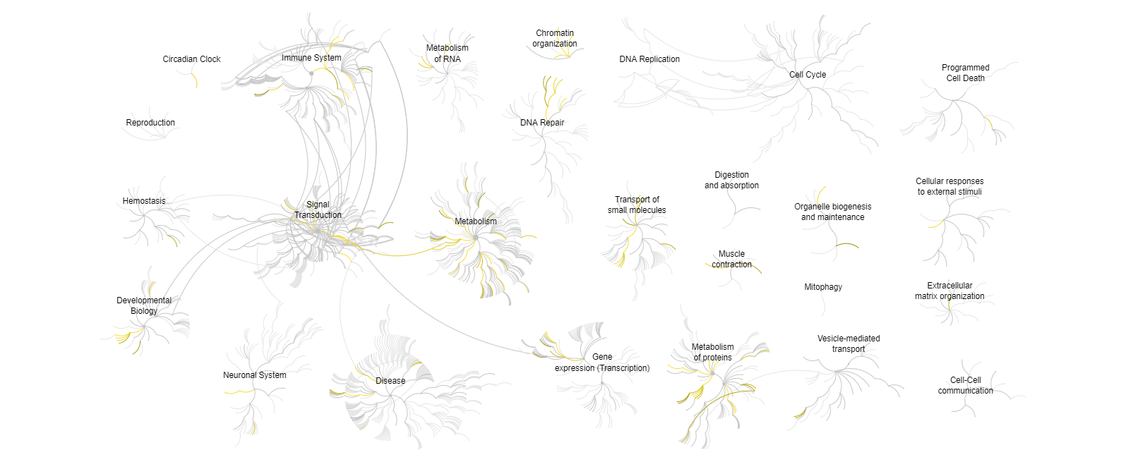
Proteins of Interest

Slide 5
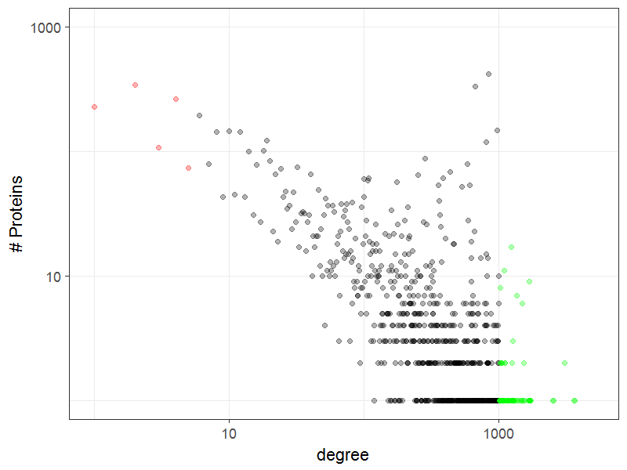
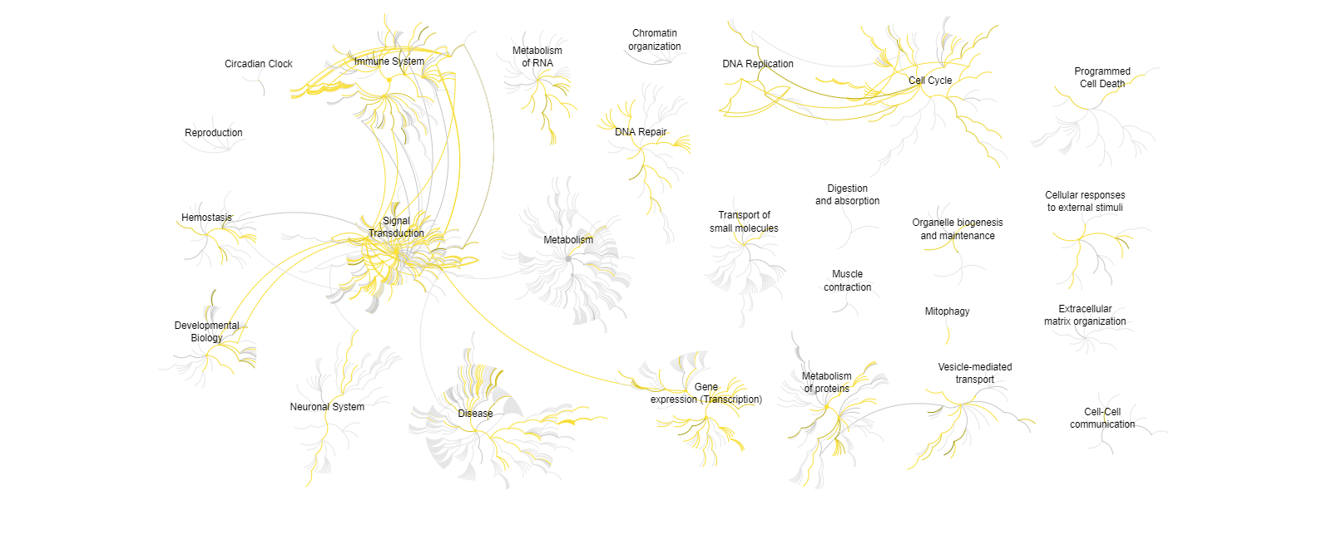
Proteins of Interest
Ubiquitin
Guanine nucleotide-binding protein
DNA-directed RNA polymerase
Tubulin

Slide 6
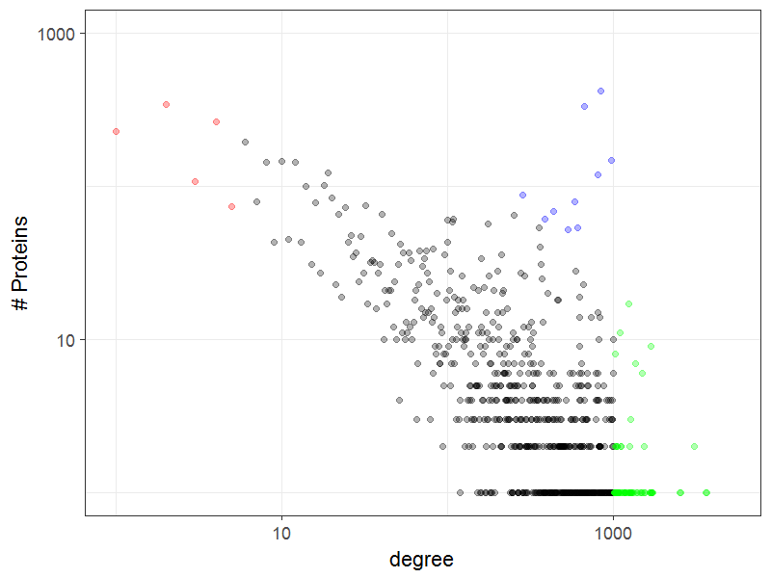
Proteins of Interest
Hydroxytryptamine receptor
Ribosomes
Ubiquitin-protein ligase Immunoglobulin Keratin Zinc finger protein Olfactory Receptor

Slide 7

Pathway archeology

Slide 8
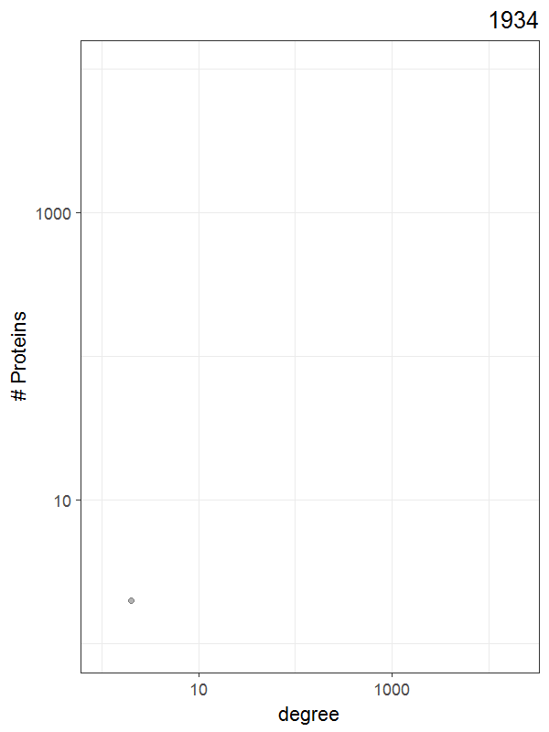
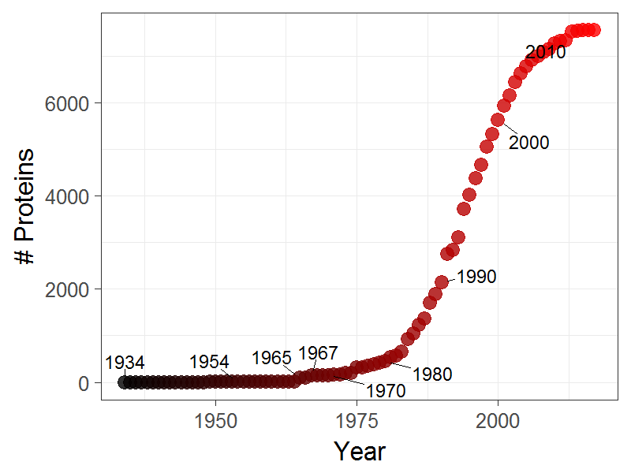
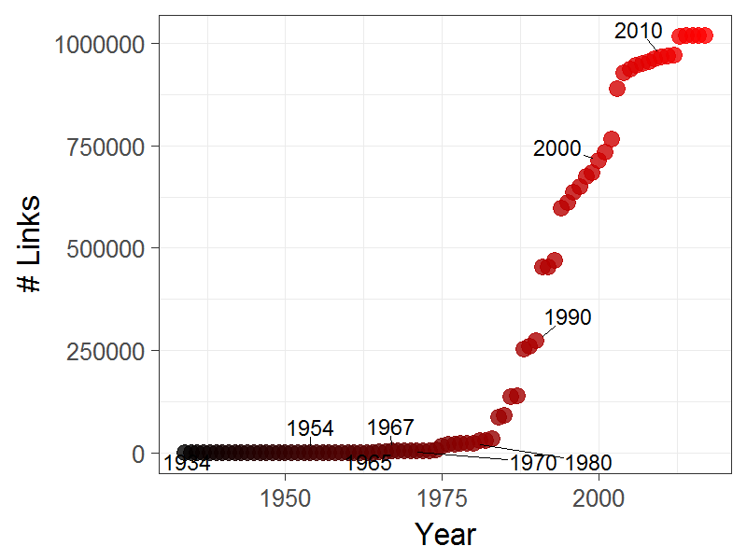
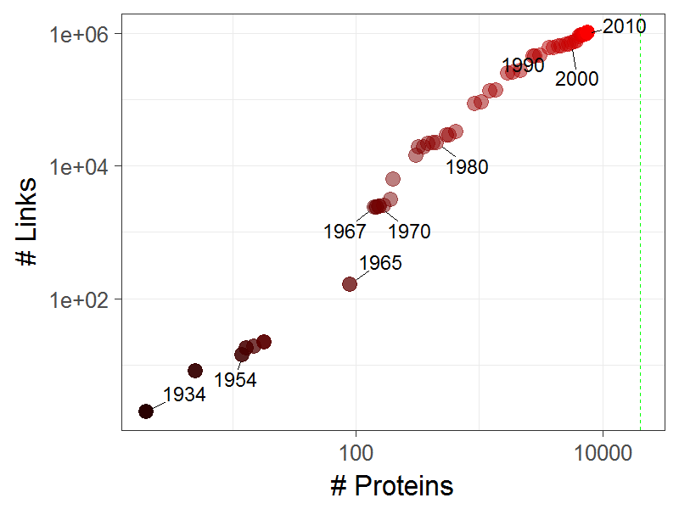
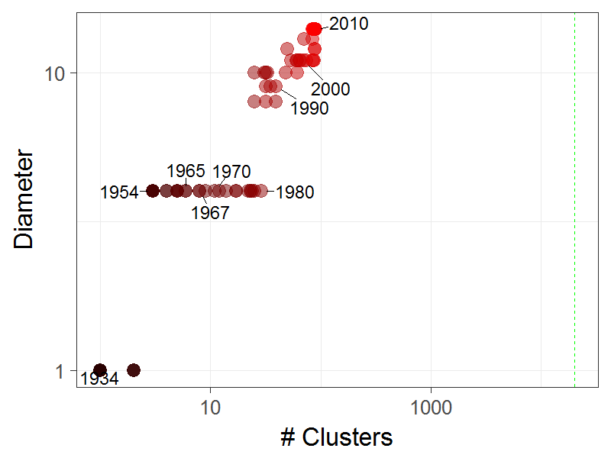
Pathway archeology

Slide 9
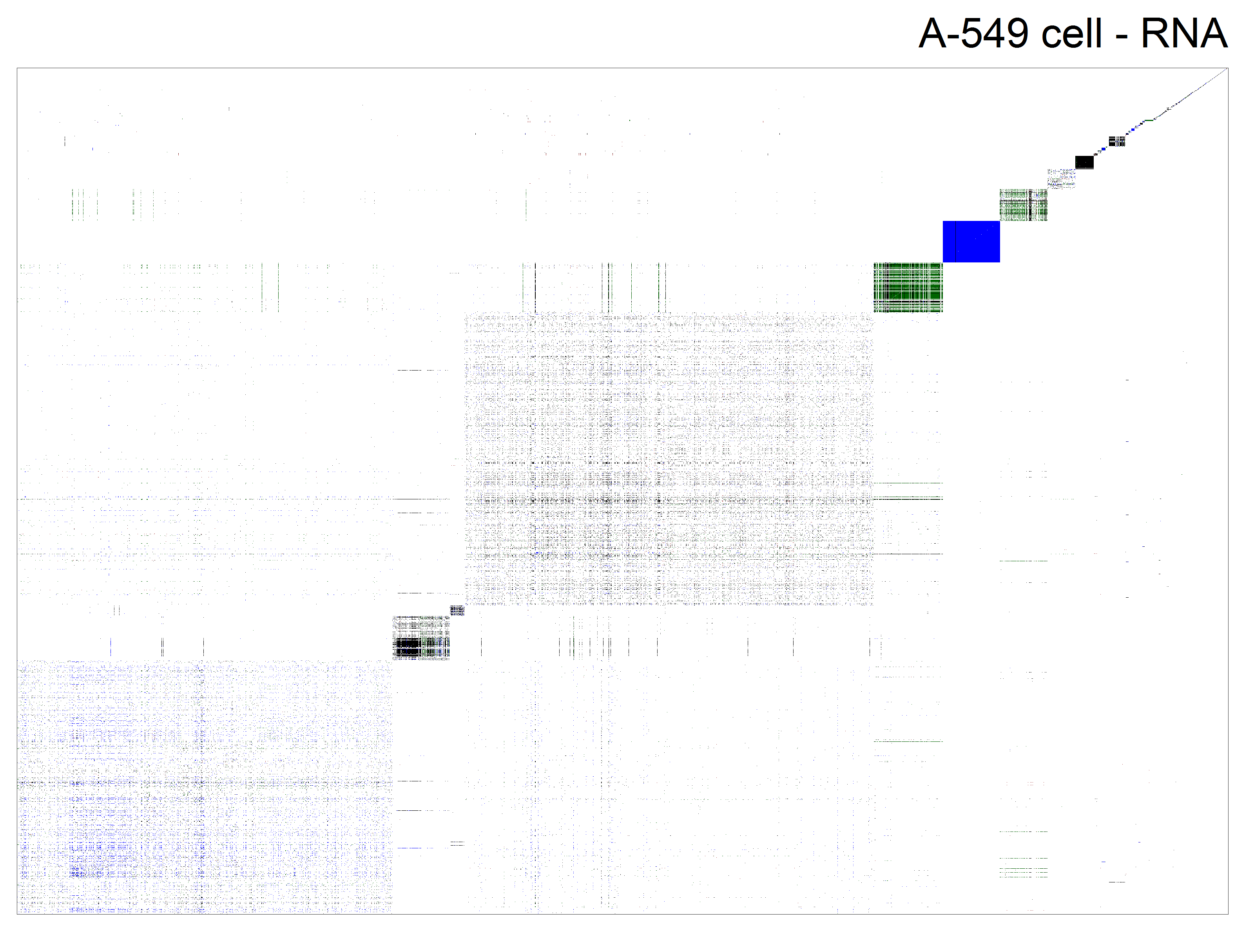
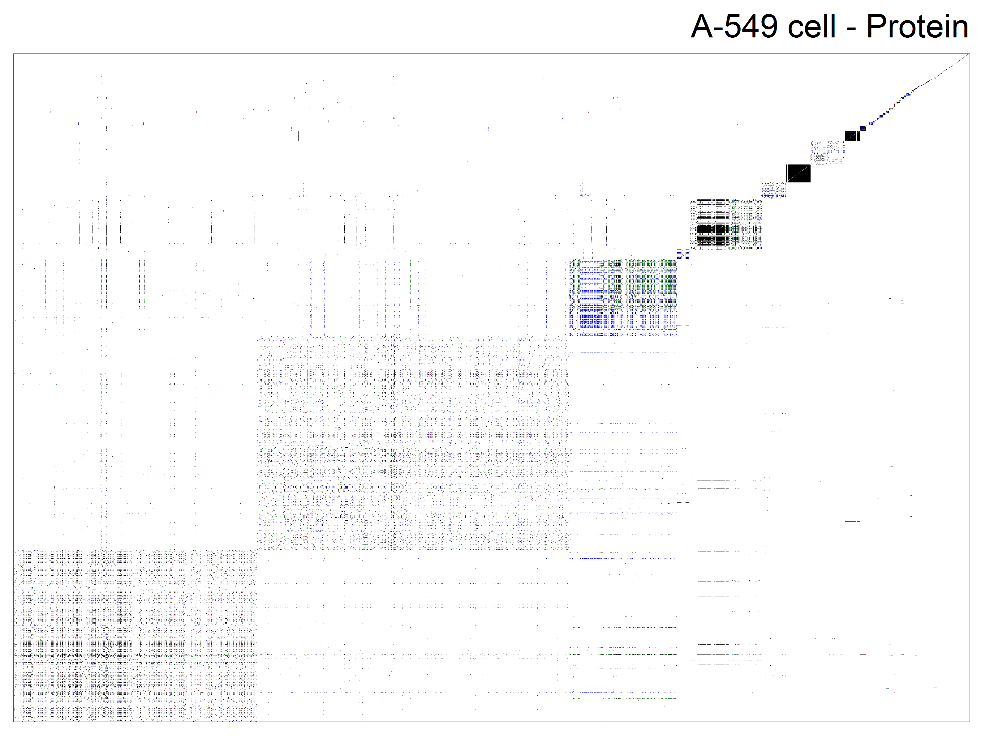
Tissue - Cell Specificity
RNA: 35/93 Proteins: 35/157

Slide 10
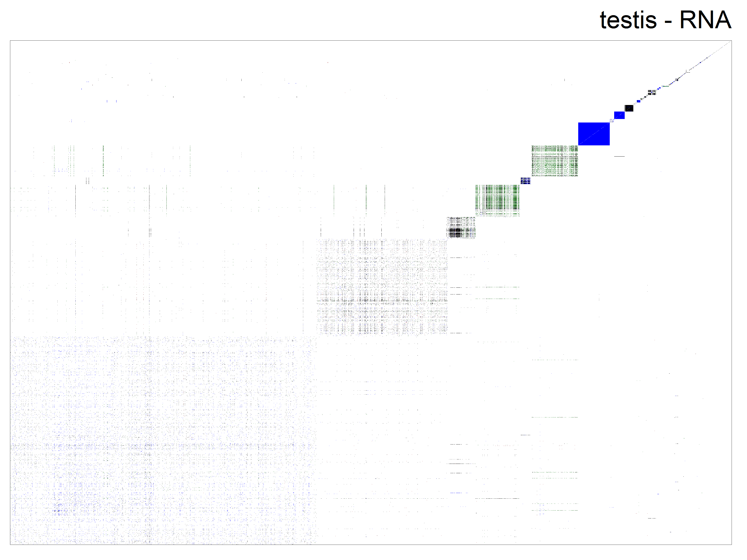
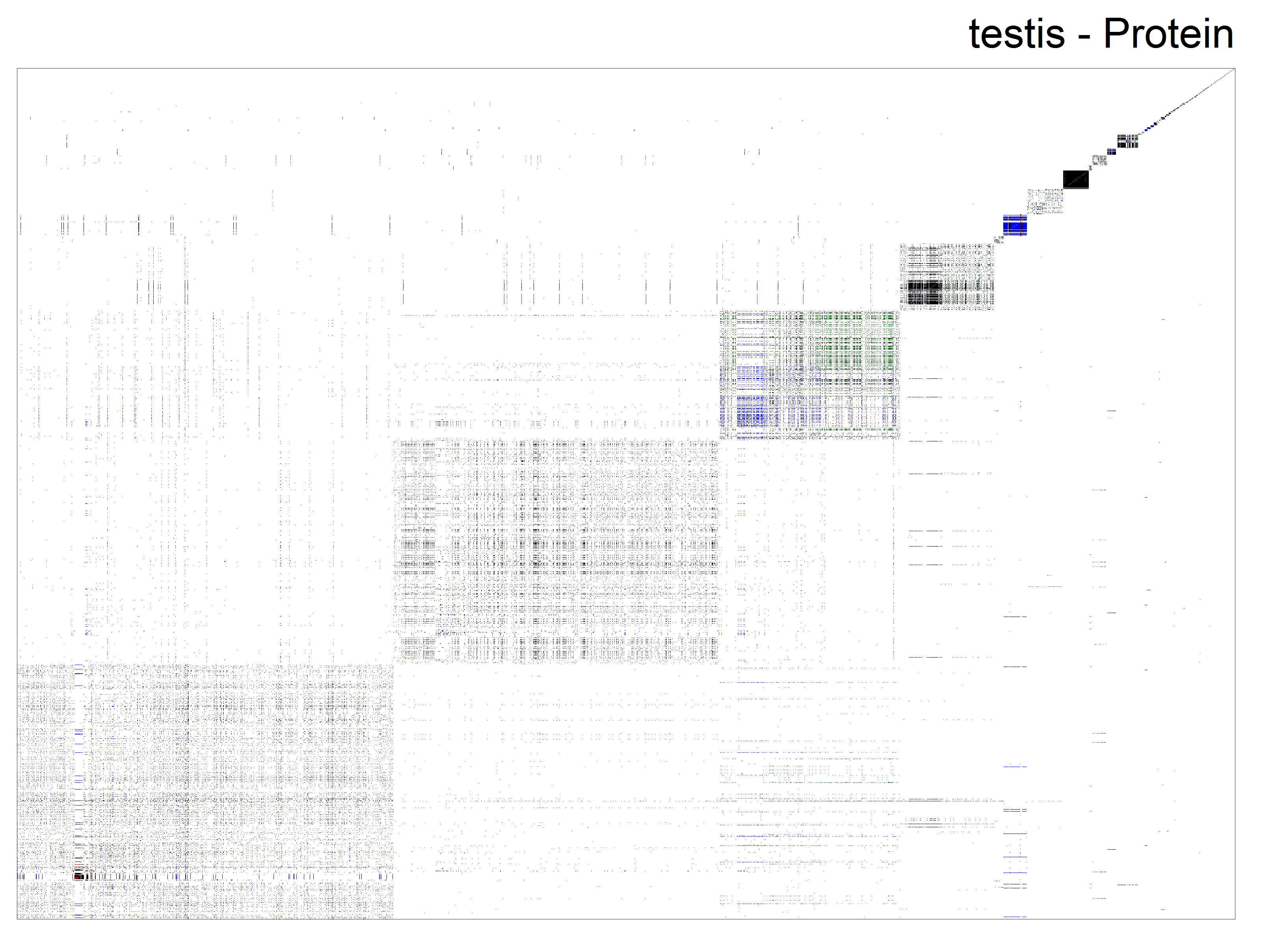
Tissue - Cell Specificity

Slide 11

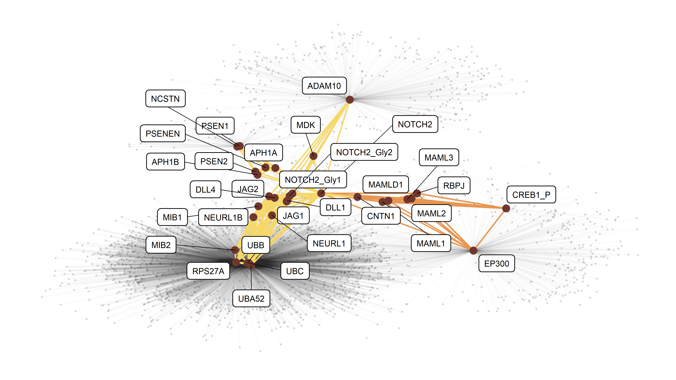
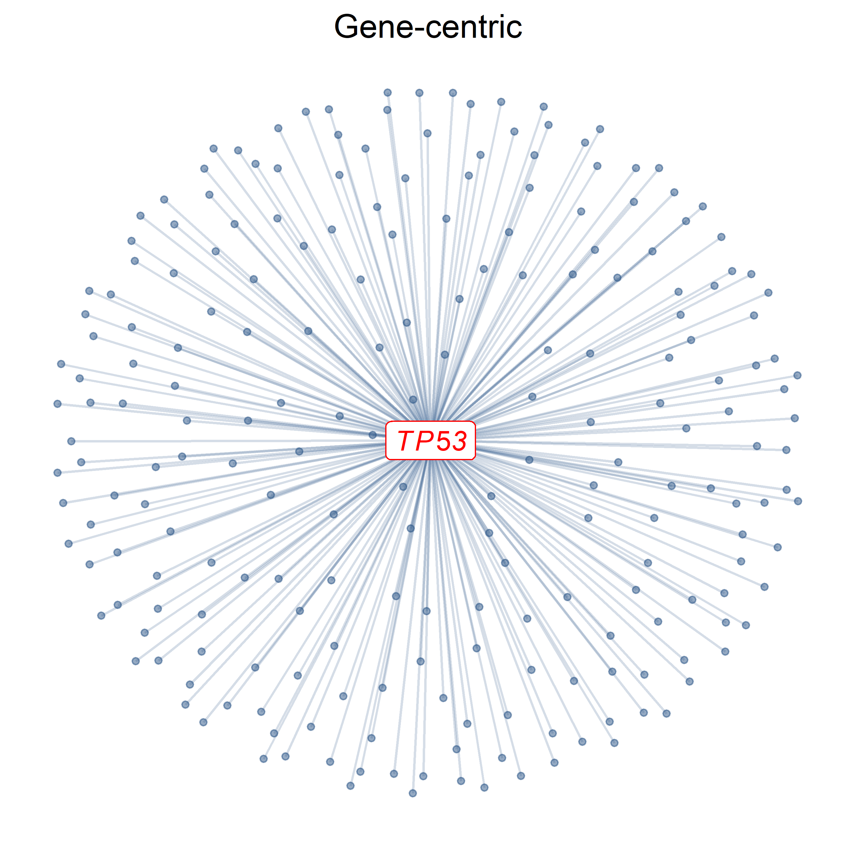
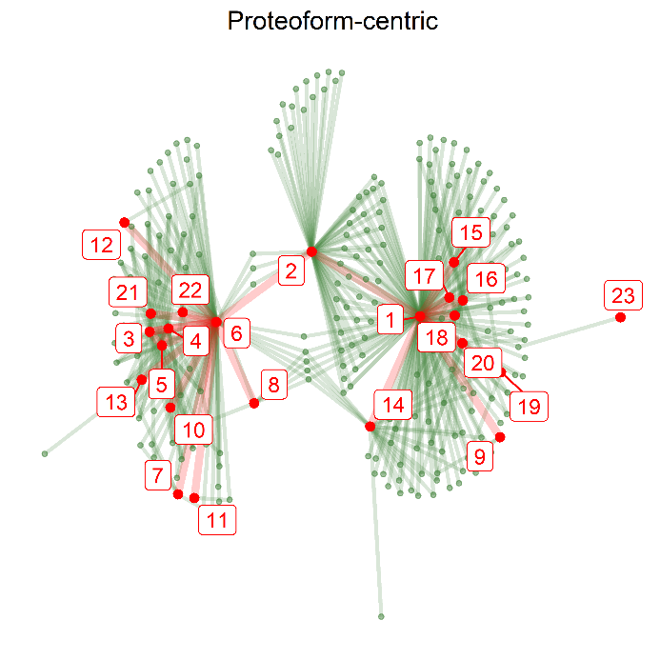
Proteoform Networks
Try it! github.com/PathwayAnalysisPlatform/PathwayMatcher
DOI: 10.1101/375097

Slide 12
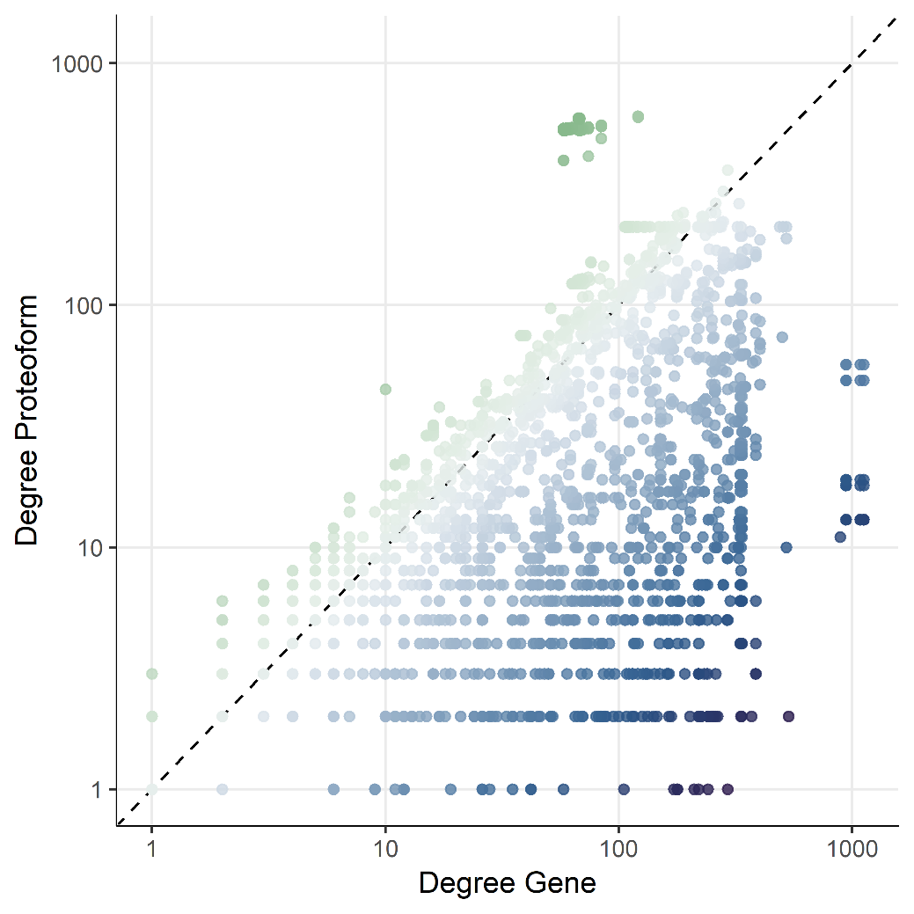
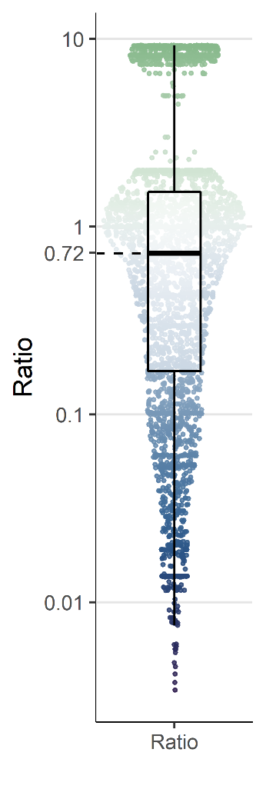
Different Topology
DOI: 10.1101/375097

Slide 13
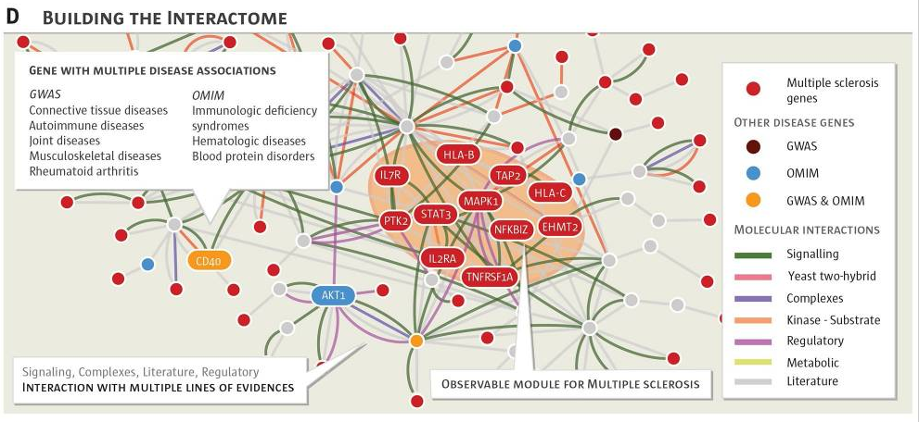
PTM-mediated Network Organization
DOI: 10.1126/science.1257601

Slide 14
Take home message
No one database/algorithm fits all
Be aware about internal structure prior to analysis
Be careful about underlying object models and identifiers
Use the right level of granularity - coverage for your analyses
Be sceptical, always QC in details

